Slide 1
Overview of Digital Elevation from Shuttle Radar Topography Mission (SRTM) and Advanced Spaceborne Thermal Emission and Reflection Radiometer (ASTER)

Slide 2
Learning Objectives
By the end of this presentation, you will be able to:
Understand SRTM and ASTER Digital Elevation Modeling (DEM) data
Access DEM for Flood Management Applications

Slide 3
Outline
Overview of SRTM and ASTER DEM Data
SRTM and ASTER DEM Data Access
Global Data Explorer (GDEx)
Consultative Group for International Agricultural Research (CIGAR)
Demonstration of GDEx

Slide 4
Overview of SRTM and ASTER DEM Data

Slide 5
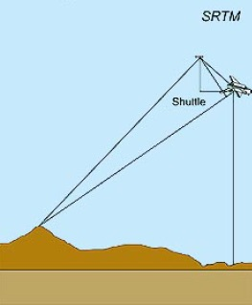
What is SRTM?
http://www2.jpl.nasa.gov/srtm/mission.htm
A c-band (5.6 cm) radar mission
On NASA Space Shuttle Endeavour
Completed February 2000
176 orbits around Earth in 11 days
Acquired digital terrain elevation data of all land between 60ºN- 56ºS latitude
~80% of Earth’s total land mass
Image Credit (Right): DLR
Notes:
To acquire topographic (elevation) data, the SRTM payload was outfitted with two radar antennas. One antenna was located in the shuttle's payload bay, the other on the end of a 60-meter (200-foot) mast that extended from the payload pay once the Shuttle was in space

Slide 6
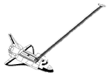
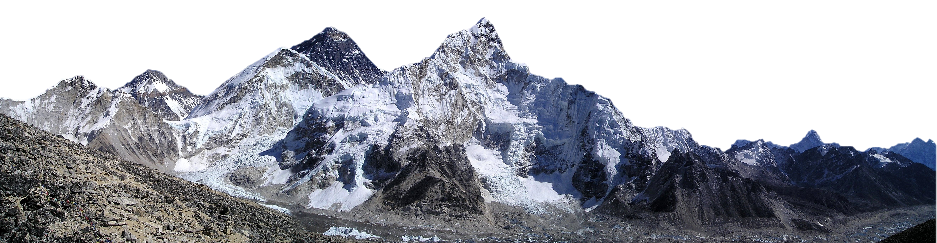
SRTM Digital Terrain Data
http://www2.jpl.nasa.gov/srtm/instr.htm
baseline
SRTM used interferometry to gather topographic (elevation) data
Interferometry:
two radar images of the same area are taken from different views
the difference in the two images determines the height of the surface in the digital elevation model (DEM)
Transmitted Wave
Radar signals being transmitted and received on the SRTM mission (not to scale)
Received Wave
Based on a JPL graphic: http://www2.jpl.nasa.gov/srtm/instrumentinterferometry.html
Notes:
To acquire topographic (elevation) data, the SRTM payload was outfitted with two radar antennas. One antenna was located in the shuttle's payload bay, the other on the end of a 60-meter (200-foot) mast that extended from the payload pay once the Shuttle was in space

Slide 7
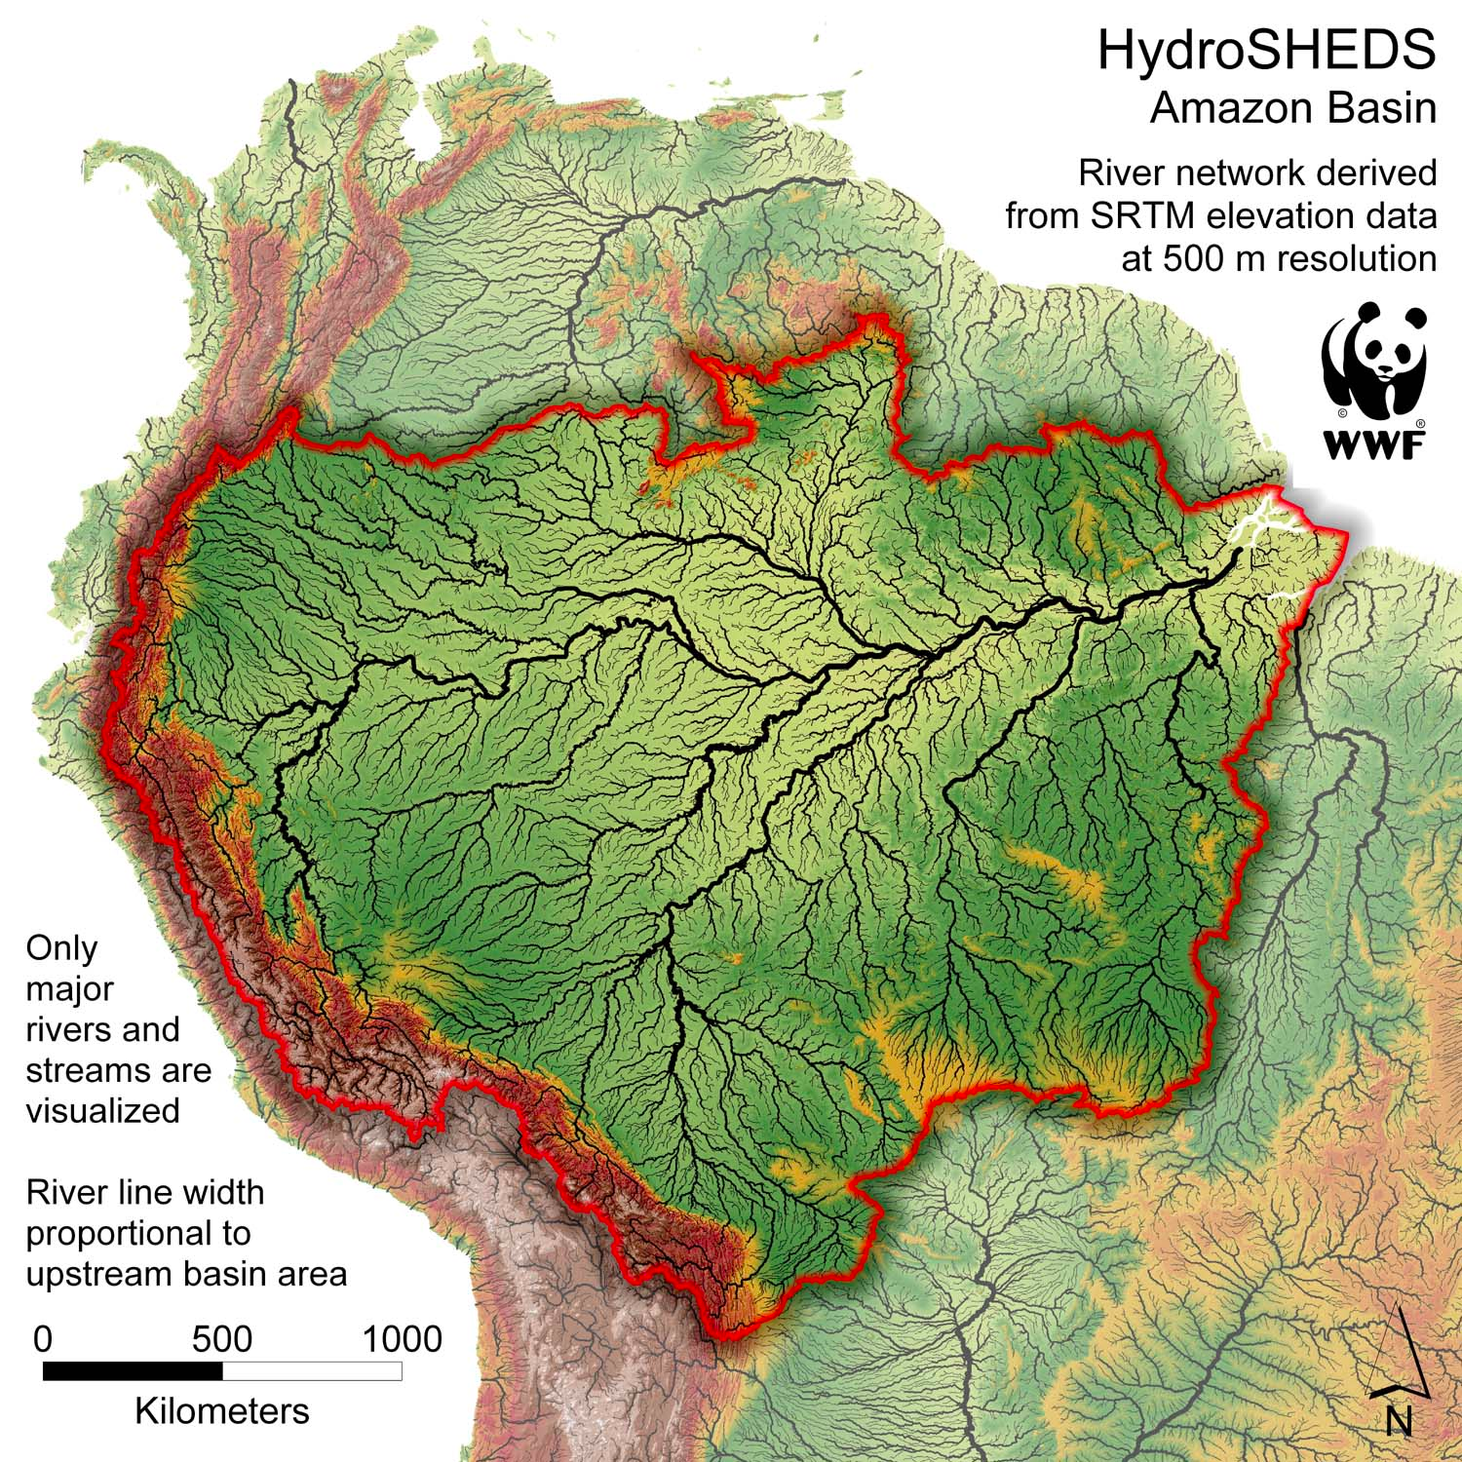
NASA SRTM Version 3.0 (SRTM Plus)
As of 2015, terrain data are available at 1 arc second or 30 m spatial resolution
Eliminated voids in SRTM data by filling with:
ASTER GDEM2
USGS GMTED2010
USGS National Elevation Dataset (NED)
mage Credit: WWF
Notes:
GMTED2010 (Old GTOP30)
New data sources include global Digital Terrain Elevation Data (DTED�) from the Shuttle Radar Topography Mission (SRTM), Canadian elevation data, Spot 5 Reference3D data, and data from the Ice, Cloud, and land Elevation Satellite (ICESat). GMTED2010 provides a new level of detail in global topographic data. The GMTED2010 product suite contains seven new raster elevation products for each of the 30-, 15-, and 7.5-arc-second spatial resolutions and incorporates the current best available global elevation data.

Slide 8
Advanced Spaceborne Thermal and Reflection Radiometer (ASTER)
http://asterweb.jpl.nasa.gov/
Onboard Terra
Polar orbiting satellite launched Dec 1999
Spatial Coverage and Resolution
Global
Swath Width: 60 km
Spatial Resolution Varies:
15 m
30 m
90 m
Images of New Zealand glaciers in 1990 (Landsat, top) and 2017 (ASTER, bottom)

Slide 9
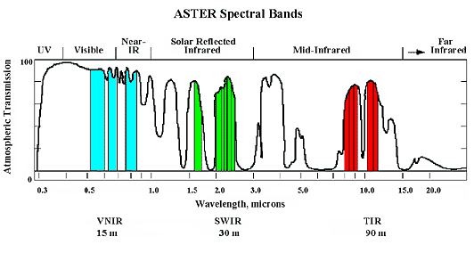
Advanced Spaceborne Thermal and Reflection Radiometer (ASTER)
http://asterweb.jpl.nasa.gov/
Spectral Bands
14 bands (visible to thermal IR bands)
Bands 1-3: 15 m (VNIR)
Bands 4-9: 30 m (SWIR)
Bands 10-14: 90 m (TIR)
Status alert: ASTER SWIR data acquired since Apr 2008 not usable

Slide 10
ASTER Global Digital Elevation Model (GDEM V2)
http://asterweb.jpl.nasa.gov/gdem.asp
A joint product developed and by NASA and the Ministry of Economy, Trade, and Industry (METI) of Japan
Uses ASTER VNIR stereo pair images to derive DEM
GDEM version 2 is available since 2011, based all available ASTER stereo images
Covers land surfaces between 83°N and 83°S and is composed of 22,600 1°- by -1° tiles of 30 m resolution
Notes:
“GDEM Version 2 shows significant improvements over the previous release. However, users are advised that the data contains anomalies and artifacts that will impede effectiveness for use in certain applications. The data are provided "as is," and neither NASA nor METI/Japan Space Systems (J-spacesystems) will be responsible for any damages resulting from use of the data.”

Slide 11
SRTM and GDEM2 Accuracy
Results from the CONUS absolute vertical accuracy assessment (in meters)
DEM | Minimum | Maximum | Mean | Standard Deviation | RMSE | LE95
GDEM2 | -137.37 | 64.80 | -0.20 | 8.68 | 8.68 | 17.01
NED | -46.21 | 16.42 | -0.33 | 1.81 | 1.84 | 3.61
SRTM | -28.67 | 28.58 | 0.73 | 3.95 | 4.01 | 7.86
GDEM1 | -127.74 | 105.41 | -3.69 | 8.58 | 9.34 | 18.31
Based on comparison with 18000 geodetic points over the U.S.
“…the GDEM validation team recommends the release of the GDEM2 to the public, acknowledging that, while vastly improved, some artifacts still exist which could affect its utility in certain application” - ASTER GDEM team [ https://pubs.er.usgs.gov/publication/70005960 ]
Notes:
ASTER Global Digital Elevation Model Version 2 - summary of validation results (2nd ed., Federal Government Series, Rep.). (2011). Retrieved from https://pubs.er.usgs.gov/publication/70005960

Slide 12
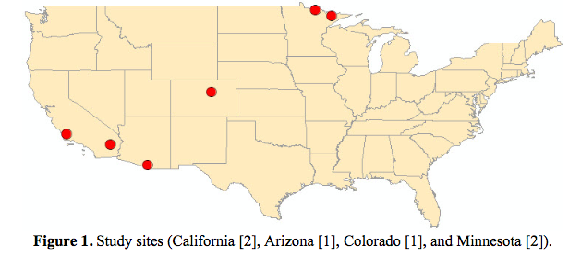
SRTM and GDEM2 Accuracy
DEM data accuracy depends on location and land cover categories
Land Cover | SRTM (rmse m) | GDEM2 (rmse m)
Grass & Shrub | 12.36 | 16.6
Deciduous | 25.49 | 20.79
Evergreen | 24.76 | 22.23
Mixed | 18.81 | 10.03
Tighe, M. L., & Chamberlain, D. (2009). Accuracy Comparison of the SRTM, ASTER, NED, NEXTMAP USA Digital Terrain Model Over Several USA Study Sites. In ASPRS/MAPPS 2009 Conference Proceedings. San Antonio, TX. Retrieved from http://www.asprs.org/a/publications/proceedings/sanantonio09/Tighe_2.pdf

Slide 13
DEM Applications
Useful for mapping hazardous terrain
Calculate:
slope and aspect
catchment area
forest canopy height
Models:
runoff
stream networks
landslides
USGS HydroSHEDS

Slide 14
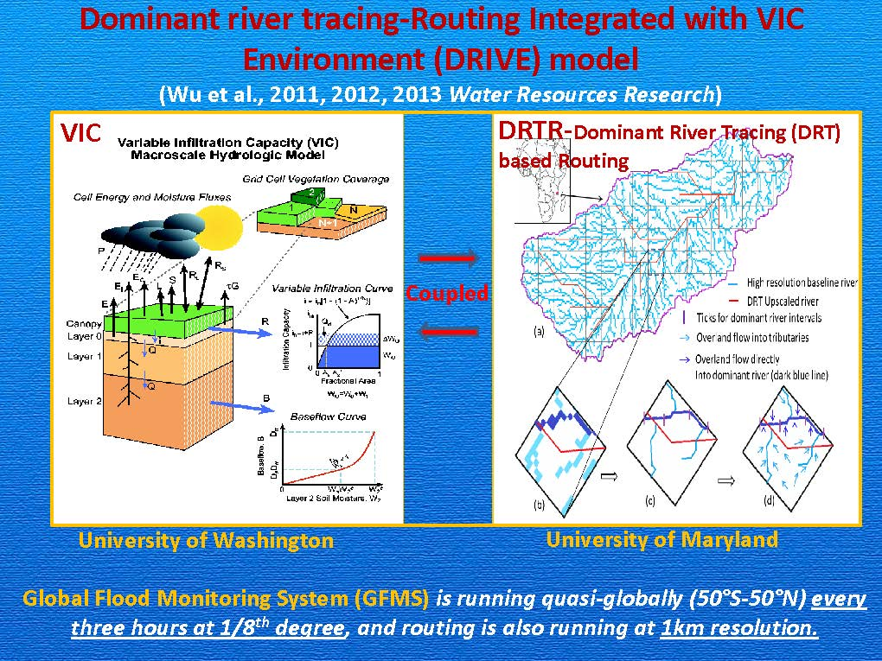
SRTM DEM Application in Flood Modeling
The Global Flood Monitoring System (GFMS) uses HydroSHEDS* derived from SRTM DEM is used in for identifying river networks for routing models
*(http://hydrosheds.org/)
Wu et al., Real-time Global Flood Monitoring and Forecasting using an Enhanced Land Surface Model with Satellite and NWP model based Precipitation. GFMS. http://flood.umd.edu/GFMS_conference.pdf

Slide 15
SRTM and ASTER DEM Data Access

Slide 16
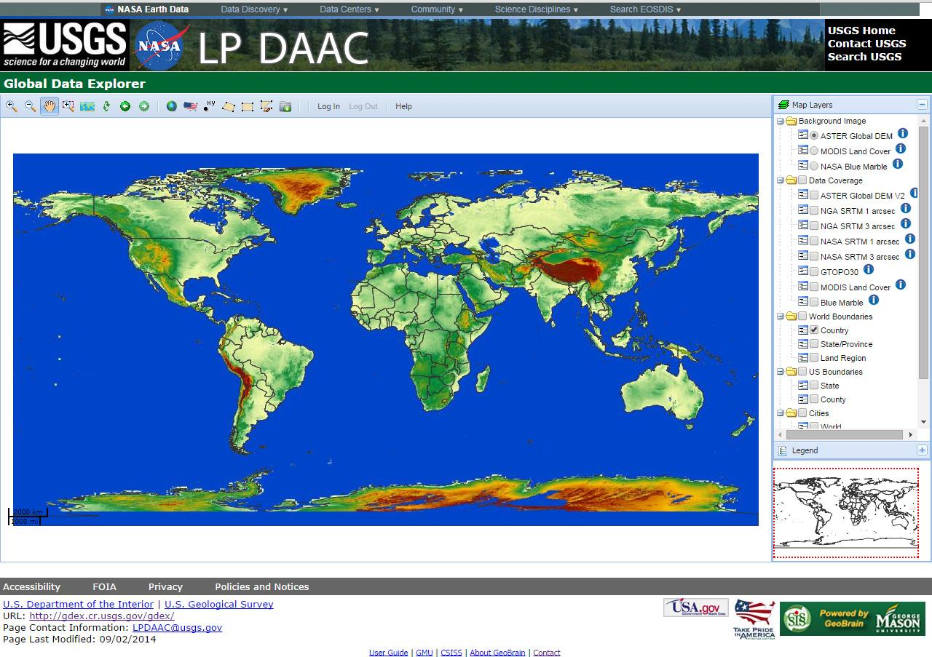
Global Data Explorer (GDEx)
http://gdex.cr.usgs.gov/
Seamless data viewer that provides access to multiple sources of digital elevation data sets
Users can subset and download data by area of interest in multiple formats and projections
Requires user registration via http://urs.earthdata.nasa.gov
Data can be previewed before downloading

Slide 17
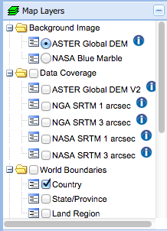
SRTM V3 and ASTER DEM from GDEx
http://gdex.cr.usgs.gov/
30 m data

Slide 18

SRTM V3 and ASTER DEM from GDEx
http://gdex.cr.usgs.gov/
Login with your NASA Earthdata username and password
Notes:
Based on ~800 geodetic sites

Slide 19
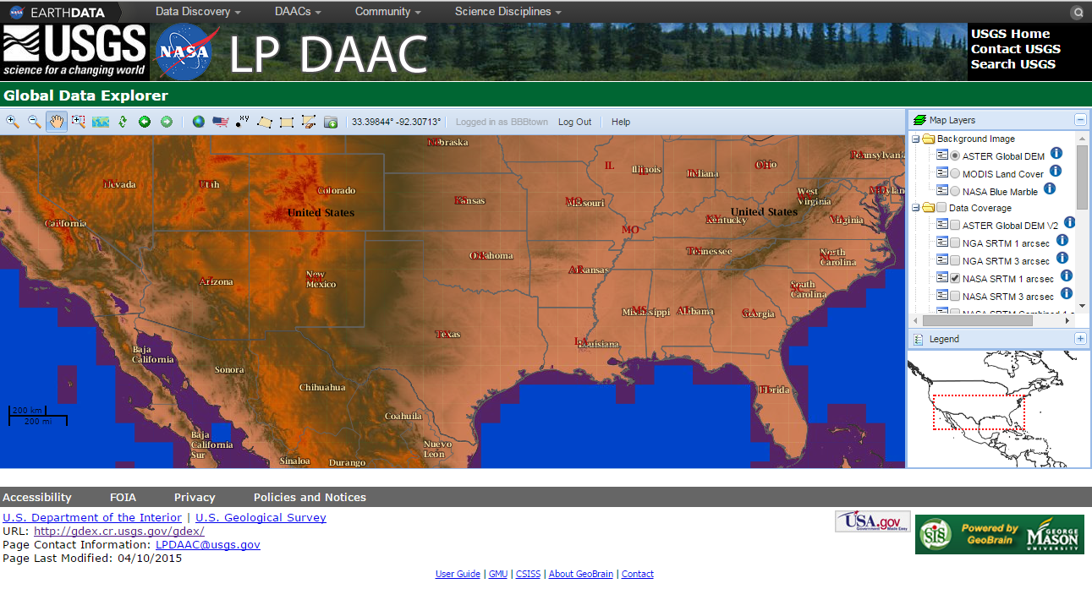

GDEx: SRTM Data Selection
http://gdex.cr.usgs.gov/
Download
Zoom
Define region of interest by bounding box, state, country, or lat/lon
Refresh
Notes:
Based on ~800 geodetic sites

Slide 20
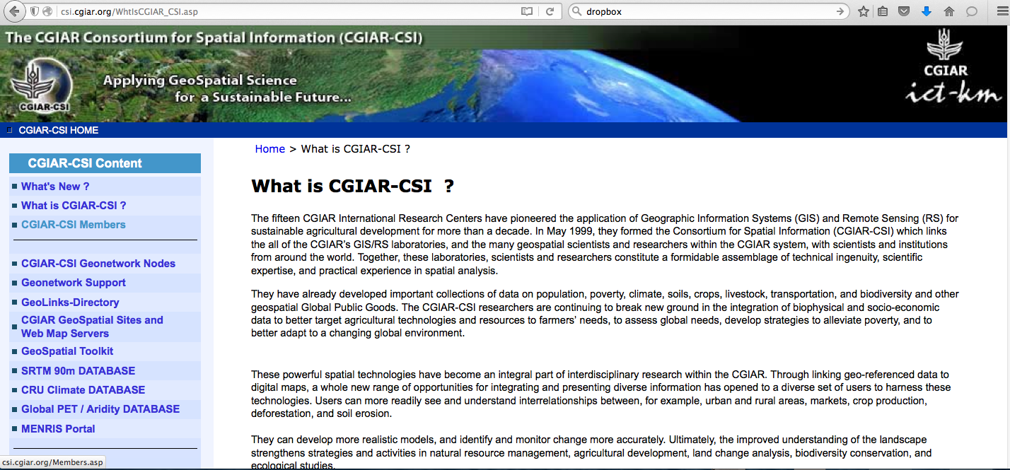
SRTM Data from CGIAR-CSI
http://csi.cgiar.org/WhtisCGIAR_CSI.asp
CGIAR-CSI: Consultative Group for International Agricultural Research Consortium of Spatial Information
SRTM data (90 m)

Slide 21
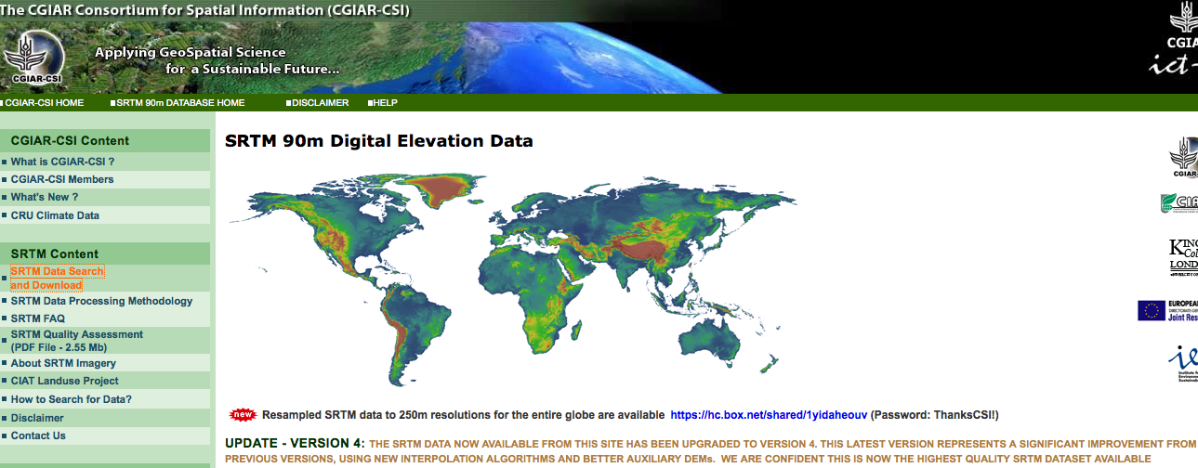
CGIAR-CSI: SRTM Data Access
Click to select and download data

Slide 22
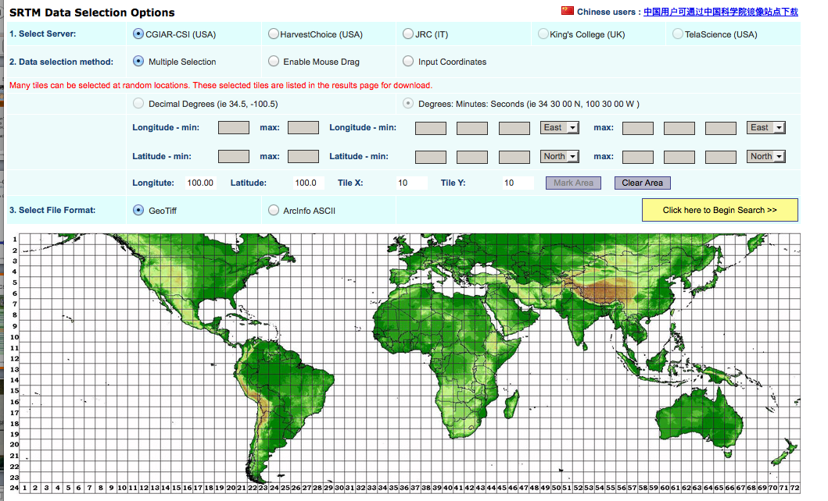
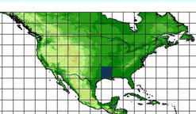
CGIAR-CSI: SRRTM Data Selection
Spatial selection can be by lat/lon
Clear Grid Selection
or by clicking on the grid(s)
Select data format

Slide 23
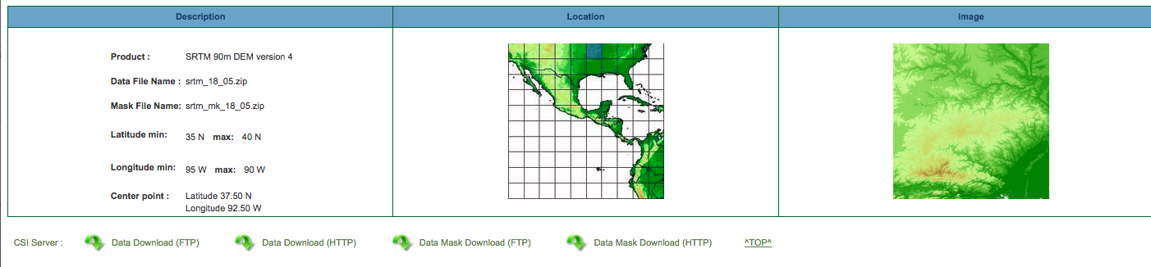
CGIAR-CSI: SRTM Data Download
Download options
Digital elevation data can be downloaded as GeoTIFF

Slide 24
GDEx and CGIAR-CSI
Both tools are easy to use with spatial subsetting
Data can be downloaded as GeoTIFF to import in GIS
GDEx SRTM is 30 m whereas CGIAR-CSI is 90 m
CGIR-CSI provides combined multiple tiles whereas GDEx provides a series of individual tiles
GDEx also provides access to ASTER GDEM2 and other DEM data
GDEx requires user registration and login through NASA Earthdata

Slide 25
Next Demonstration of GDEx

